Slide 1

eLaundromat
Ankita Jawale (Uid: U01506949)
Geetha Lakkarasu (Uid: U01523131)

Slide 2
Problems
Busy Schedule
Long waiting queue
Laundromat timings

Slide 3
Users Targeted
Employees
Students
Senior citizens

Slide 4

eLaundromat
Our App mainly focus on saving time of customers
We are offering an online 24/7 laundry service. People in today’s world are very busy with their works all day. It becomes very difficult for them to take time to go for laundry. Our designed app will help them save a lot of time as it’s a 24 hours’ service and our employees will reach out to customers for pickup of materials.

Slide 5
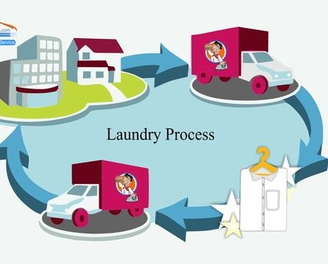

Slide 6
How it Works
To begin, an individual has to install the app and needs to sign up providing the personal details and also address to pick up.
Then we ask for number of clothes, type of clothes (delicate, cotton or silk), quick wash or normal wash, type of detergent mentioned by the customer, drying time, permanent press and folding clothes for which we charge for our extra services.

Slide 7

Through our service there is no need for customers to visit laundry. It hardly takes 5 minutes to give details and get laundry done with service at their door steps.

Slide 8

Extra Features
We also provide permanent press on customer request

Slide 9
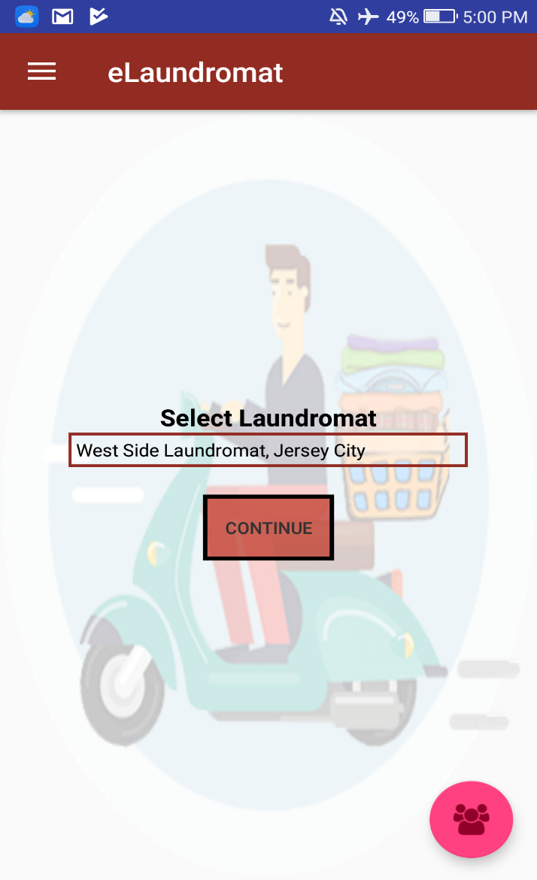
eLaundromat App

Slide 10
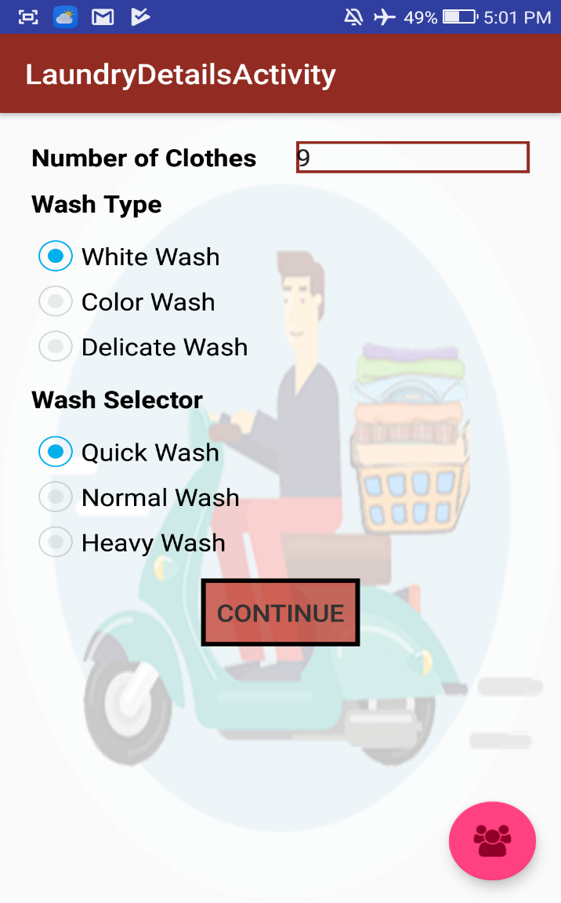
Details Acitivity

Slide 11
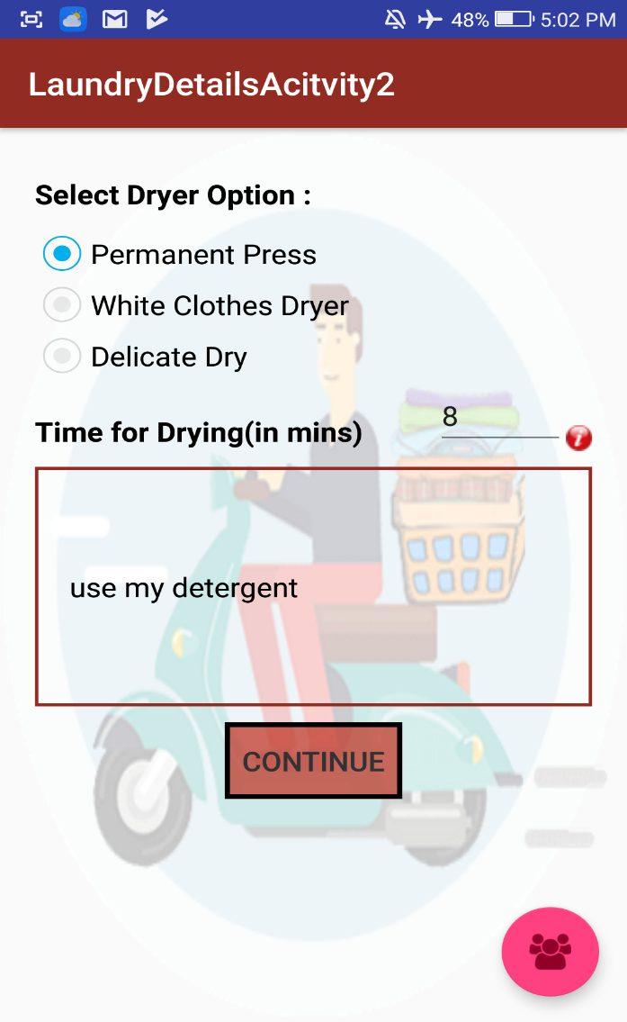
Activity 2

Slide 12
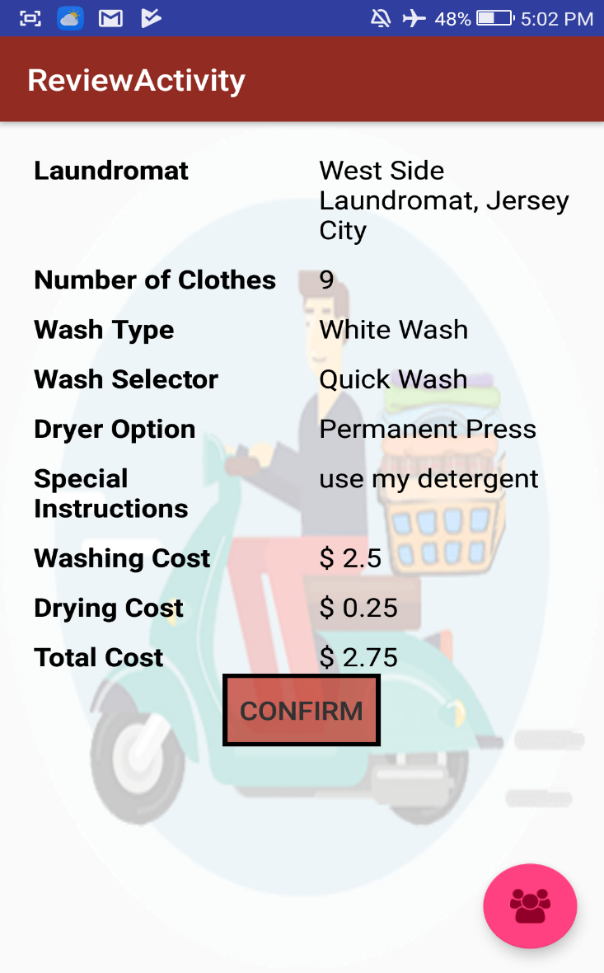
Review

Slide 13
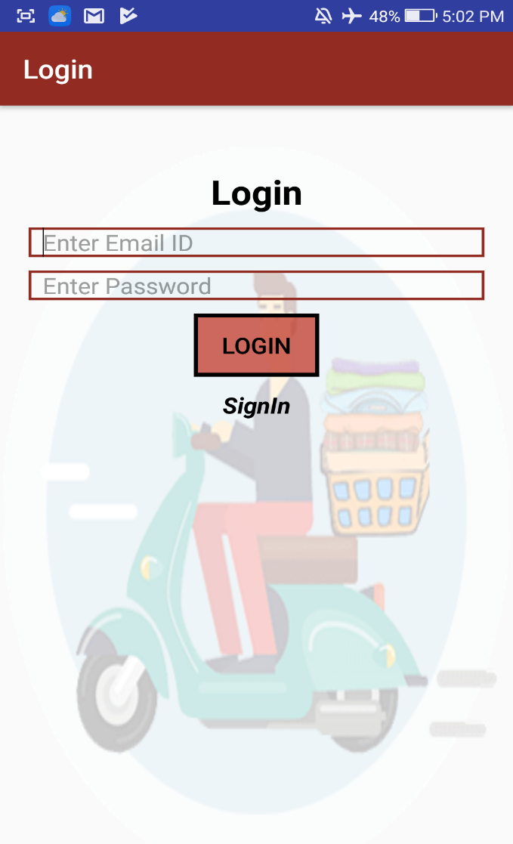
Login page

Slide 14
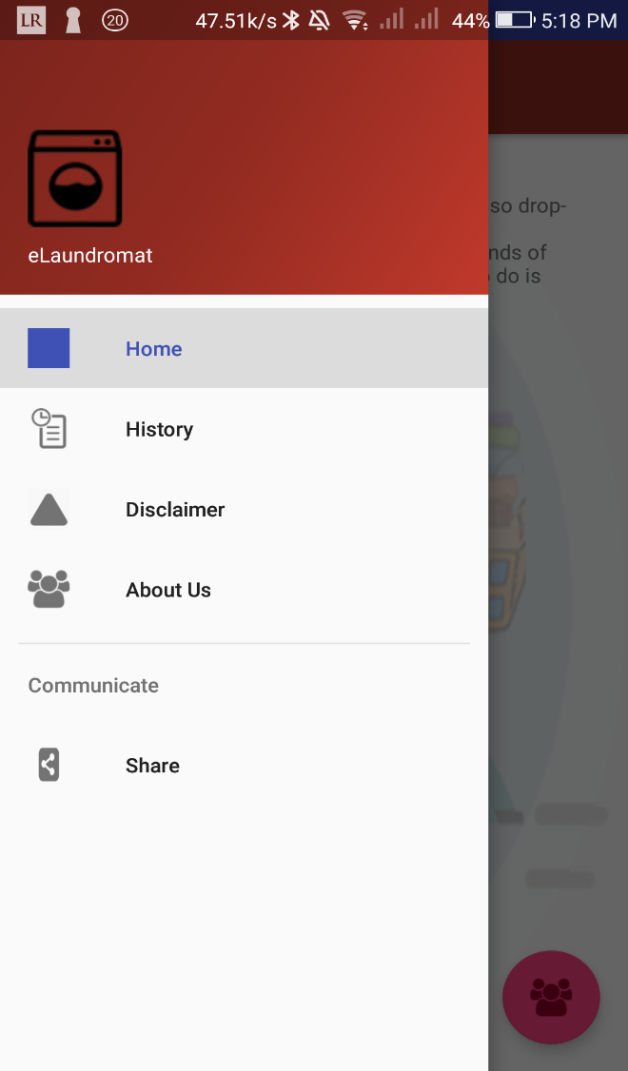
Home

Slide 15
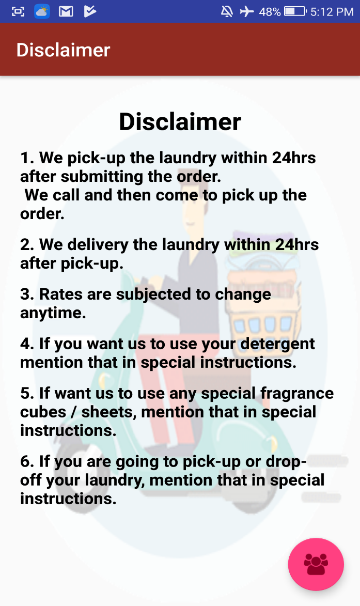
Disclaimer

Slide 16
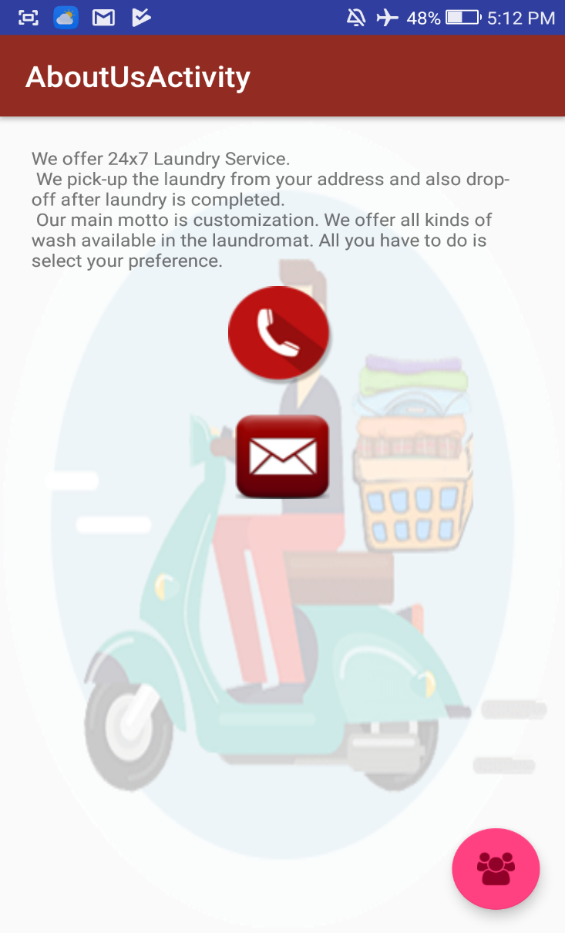
About us :

Slide 17
YouTube Video Link
https://youtu.be/_9kXPILkhlQ

Slide 18
Thank you ☺

